Slide 1
Introduction to Computer Graphics with WebGL
More Matrix Representations and Transformations
Angel and Shreiner: Interactive Computer Graphics 7E © Addison-Wesley 2015

Slide 2
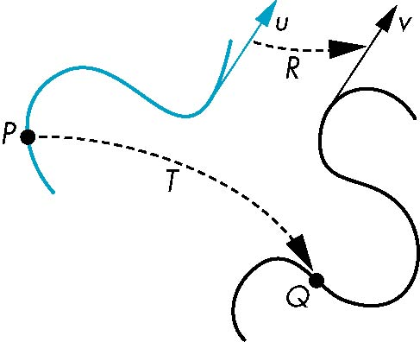
General Transformations
A transformation maps points to other points and/or vectors to other vectors
v=T(u)
Q=T(P)
Angel and Shreiner: Interactive Computer Graphics 7E © Addison-Wesley 2015

Slide 3
Affine Transformations
Line preserving
Characteristic of many physically important transformations
  Rigid body transformations: rotation, translation
  Scaling, shear
Importance in graphics is that we need only transform endpoints of line segments and let implementation draw line segment between the transformed endpoints
Angel and Shreiner: Interactive Computer Graphics 7E © Addison-Wesley 2015

Slide 4
Pipeline Implementation
T
(from application program)
frame
buffer
u
transformation
T(u)
rasterizer
v
T(v)
T(v)
T(v)
v
T(u)
u
T(u)
vertices
vertices
pixels
Angel and Shreiner: Interactive Computer Graphics 7E © Addison-Wesley 2015

Slide 5
Translation
Move (translate, displace) a point to a new location
Displacement determined by a vector d
  Three degrees of freedom
  P’=P+d
P’
d
P
Angel and Shreiner: Interactive Computer Graphics 7E © Addison-Wesley 2015

Slide 6
Translation Using Representations
Using the homogeneous coordinate representation in some frame
p=[ x y z 1]^{T}
p’=[x’ y’ z’ 1]^{T}
d=[dx dy dz 0]^{T}
Hence p’ = p + d or
x’ = x + d_{x}
y’ = y + d_{y}
z’ = z + d_{z}
note that this expression is in
four dimensions and expresses
point = vector + point
Angel and Shreiner: Interactive Computer Graphics 7E © Addison-Wesley 2015

Slide 7
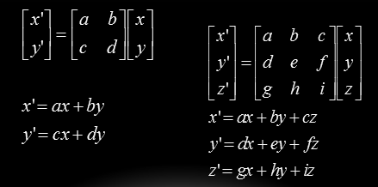
Matrix-Point (or vector) Multiplication

Slide 8
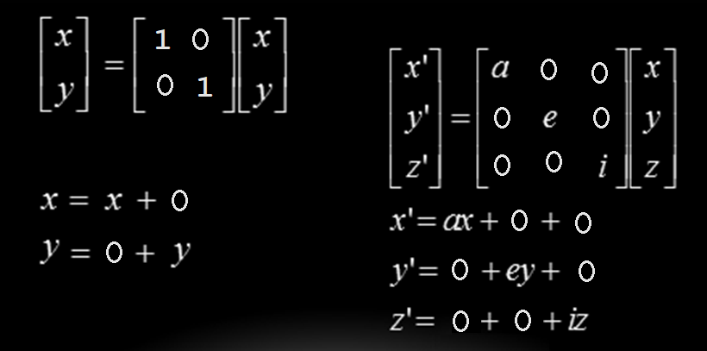
Identity Matrix Multiplication

Slide 9
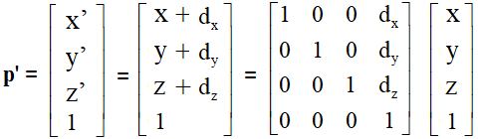
Translation Matrix
We can also express translation using a
4 x 4 matrix T in homogeneous coordinates
p' =Tp where T = T(d_{x}, d_{y}, d_{z})
T p
This form is better for implementation because all affine transformations can be expressed this way and multiple transformations can be concatenated together
Angel and Shreiner: Interactive Computer Graphics 7E © Addison-Wesley 2015

Slide 10
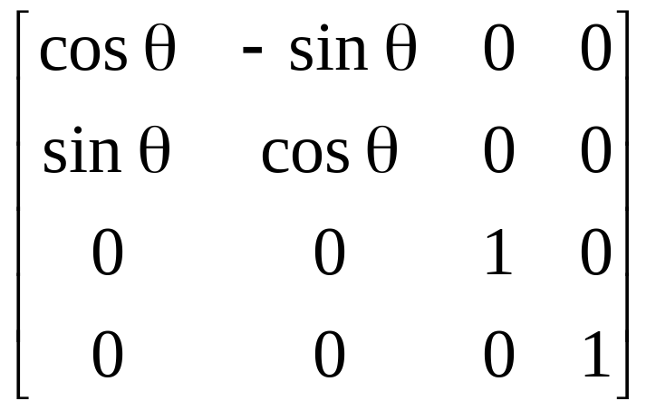
Rotation Matrix
R = R_{z}(θ) =
Angel and Shreiner: Interactive Computer Graphics 7E © Addison-Wesley 2015

Slide 11
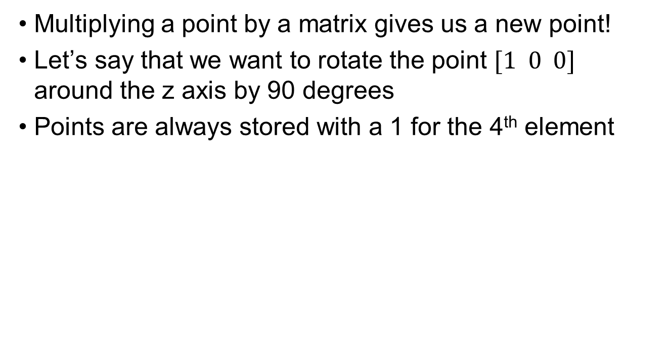
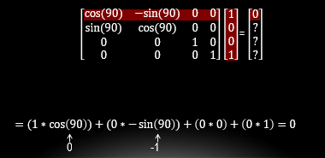
Rotation Matrix Multiplication

Slide 12
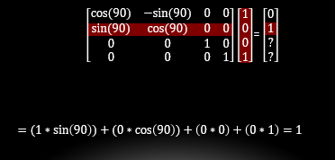
Rotation Matrix Multiplication

Slide 13
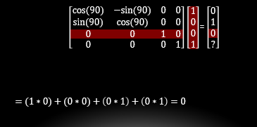
Rotation Matrix Multiplication

Slide 14
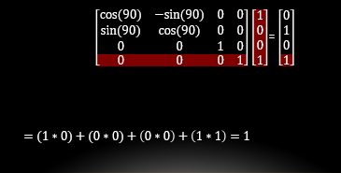
Rotation Matrix Multiplication

Slide 15
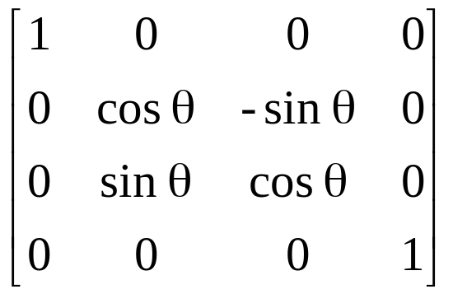
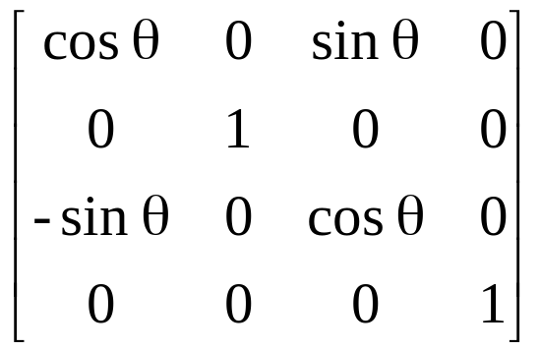
Rotation about x and y axes
Same argument as for rotation about z axis
  For rotation about x axis, x is unchanged
  For rotation about y axis, y is unchanged
R = R_{x}(θ) =
R = R_{y}(θ) =
Angel and Shreiner: Interactive Computer Graphics 7E © Addison-Wesley 2015

Slide 16
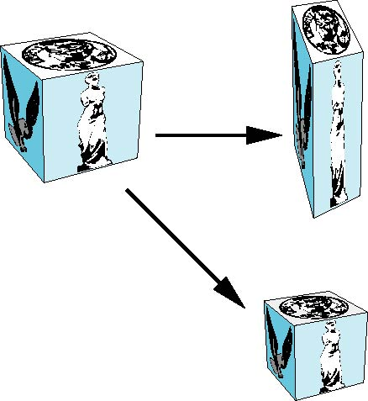
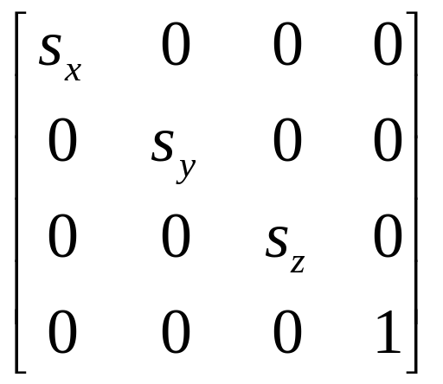
Scaling
Expand or contract along each axis (fixed point of origin)
x’=s_{x}x
y’=s_{y}y
z’=s_{z}z
p’=Sp
S = S(s_{x}, s_{y}, s_{z}) =
Angel and Shreiner: Interactive Computer Graphics 7E © Addison-Wesley 2015

Slide 17
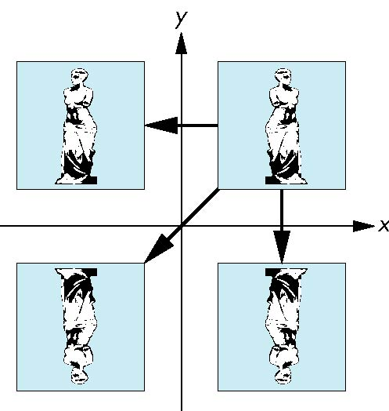
Reflection
corresponds to negative scale factors
s_{x} = -1 s_{y} = 1
original
s_{x} = -1 s_{y} = -1
s_{x} = 1 s_{y} = -1
Angel and Shreiner: Interactive Computer Graphics 7E © Addison-Wesley 2015

Slide 18
Inverses
Although we could compute inverse matrices by general formulas, we can use simple geometric observations
  Translation: T⁻¹(d_{x}, d_{y}, d_{z}) = T(-d_{x}, -d_{y}, -d_{z})
  Rotation: R ⁻¹(θ) = R(-θ)
    Holds for any rotation matrix
    Note that since cos(-θ) = cos(θ) and sin(-θ)=-sin(θ)
    R ⁻¹(θ) = R ^{T}(θ)
  Scaling: S⁻¹(s_{x}, s_{y}, s_{z}) = S(1/s_{x}, 1/s_{y}, 1/s_{z})
Angel and Shreiner: Interactive Computer Graphics 7E © Addison-Wesley 2015

Slide 19
Concatenation
We can form arbitrary affine transformation matrices by multiplying together rotation, translation, and scaling matrices
Because the same transformation is applied to many vertices, the cost of forming a matrix M=ABCD is not significant compared to the cost of computing Mp for many vertices p
The difficult part is how to form a desired transformation from the specifications in the application
Angel and Shreiner: Interactive Computer Graphics 7E © Addison-Wesley 2015

Slide 20
Order of Transformations
Note that matrix on the right is the first applied
Mathematically, the following are equivalent
p’ = ABCp = A(B(Cp))
Note many references use column matrices to represent points. In terms of column matrices
p^{’T} = p^{T}C^{T}B^{T}A^{T}
Angel and Shreiner: Interactive Computer Graphics 7E © Addison-Wesley 2015

Slide 21
General Rotation About the Origin
A rotation by θ about an arbitrary axis
can be decomposed into the concatenation
of rotations about the x, y, and z axes
R(θ) = R_{z}(θ_{z}) R_{y}(θ_{y}) R_{x}(θ_{x})
y
v
θ_{x} θ_{y} θ_{z} are called the Euler angles
θ
Note that rotations do not commute
We can use rotations in another order but
with different angles
x
z
Angel and Shreiner: Interactive Computer Graphics 7E © Addison-Wesley 2015

Slide 22
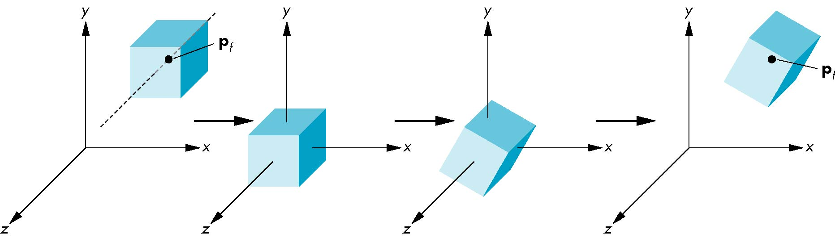
Rotation About a Fixed Point other than the Origin
Move fixed point to origin
Rotate
Move fixed point back
M = T(p_{f}) R(θ) T(-p_{f})
Angel and Shreiner: Interactive Computer Graphics 7E © Addison-Wesley 2015

Slide 23
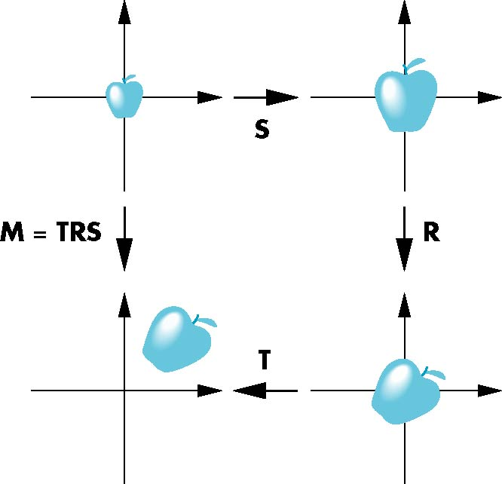
Instancing
In modeling, we often start with a simple object centered at the origin, oriented with the axis, and at a standard size
We apply an instance transformation to its vertices to
Scale
Orient
Locate
Angel and Shreiner: Interactive Computer Graphics 7E © Addison-Wesley 2015

Slide 24
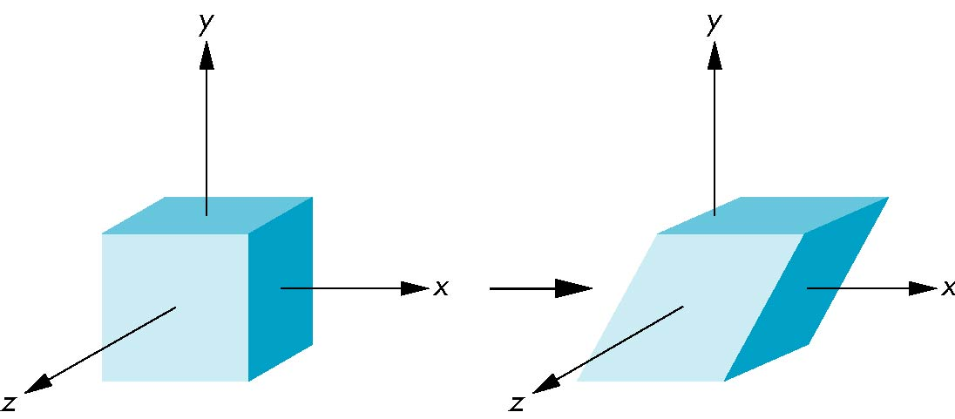
Shear
Helpful to add one more basic transformation
Equivalent to pulling faces in opposite directions
Angel and Shreiner: Interactive Computer Graphics 7E © Addison-Wesley 2015

Slide 25
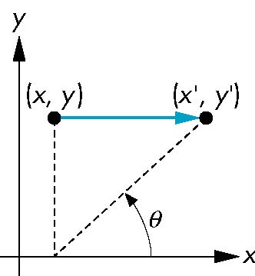
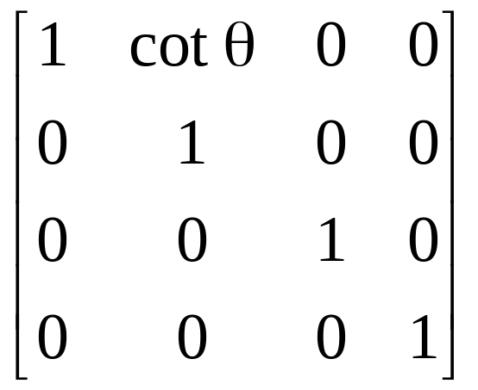
Shear Matrix
Consider simple shear along x axis
x’ = x + y cot θ
y’ = y
z’ = z
H(θ) =
Angel and Shreiner: Interactive Computer Graphics 7E © Addison-Wesley 2015

